Slide 1
MIKE 11
Rainfall Runoff using the UHM Editor

Slide 2
UHM Editor
The UHM Model
UHM (Unit Hydrograph Method) is a simple linear model
It constitutes an alternative to the NAM model for flood simulation in areas, where no stream flow records are available or where unit hydrograph techniques are already well established

Slide 3
UHM Editor
Principles of UHM Model
The UHM models divide the storm rainfall in excess rainfall (leading to runoff) and water loss (mainly infiltration).
The excess rainfall is divided in small units with constant intensity
A unit hydrograph is computed from each unit of excess rainfall
The total runoff is the sum of all unit hydrographs

Slide 4
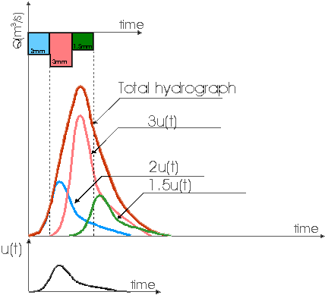
UHM Editor
Principle of UHM Model

Slide 5
UHM Editor
Main assumptions
The excess rainfall has a constant intensity within the effective duration describing a rainfall unit
The excess rainfall is uniformly distributed over the whole catchment area
The base time of the unit hydrograph resulting from an excess rain with a given duration is constant
The ordinates of the unit hydrograph is directly proportional to the rainfall intensity
The principle of superposition applies to hydrographs resulting from continuous and/or isolated periods of excess rain

Slide 6
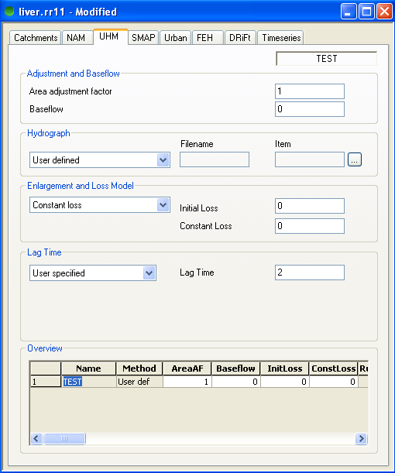
UHM Editor
Building a UHM model
Use the adjustment factor if effective rainfall differs from input time series
Use baseflow to add a constant discharge independent of the excess rainfall
Define Loss model
Constant loss
Loss proportional to rain
SCS method (uses a Curve Number and Antecedent Moisture Conditions)

Slide 7
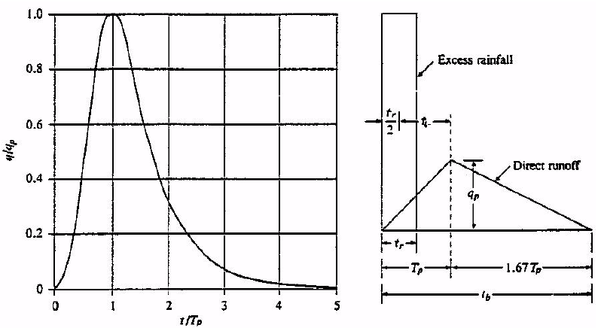
UHM Editor
Building a UHM model
Define routing method
SCS triangular
SCS dimensionless
User defined
Other models

Slide 8
UHM Editor
Building a UHM model
Define lag time
Curve Number method
(function of hydraulic length, slope and CN)
User defined
Define calculation time step
Between 22% and 27% of the lag time

